Slide 1
Inheritance

Slide 2
Inheritance
Reusability is another important feature of OOP.
It is a good practice to reuse something that already exists rather than trying to create the same all over again.
For instance, the reuse of a class that has already been tested, debugged and used many times can save the effort of developing and testing the same again.

Slide 3
Inheritance
C++ strongly supports the concept of reusability.
The C++ classes can be reused in several ways.
Once a class has been written and tested, it can be adapted by other programmers to suit their requirements.
This is basically done by creating new classes, reusing the properties of the existing ones.

Slide 4
Inheritance
The mechanism of deriving a new class from an old one is called inheritance.
The old class is referred to as the base class and the new one is called the derived class or subclass.
The derived class inherits some or all of the traits from the base class.

Slide 5
Inheritance
A class can also inherit properties from more than one class or from more than one level.
A derived class with only one base class, is called single inheritance and one with several base classes is called multiple inheritance.

Slide 6
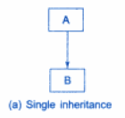
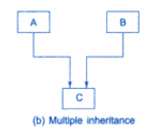
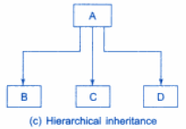
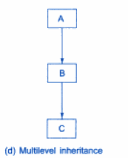
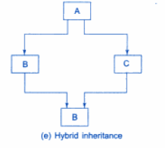
Forms of Inheritance

Slide 7
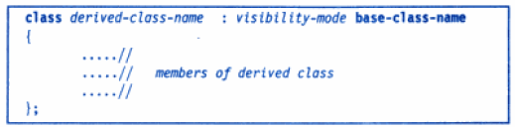
Defining Derived Classes
A derived class can be defined by specifying its relationship with the base class in addition to its own details.
The general for of deriving a derived class is :

Slide 8
Defining Derived Classes
The colon indicates that the derived class name is derived from the base class name.
The visibility mode is optional and if present, may be either private or public.
The default visibility mode is private.
Visibility mode specifies whether the feature of the base class are privately derived or publicly derived.

Slide 9
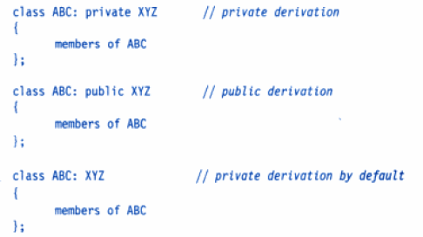
Examples

Slide 10
Key Points : Private Derivation
When a base class is privately inherited by a derived class,
‘public members’ of the base class become ‘private members’ of the derived class
the public members of the base class can only be accessed by the member functions of the derived class.
They are inaccessible to the objects of the derived class.
A public member of a class can be accessed by its own objects using the dot operator.
The result is that no member of the base class is accessible to the objects of the derived class.

Slide 11
Key Points : Public Derivation
On the other hand, when the base class is publicly inherited,
‘public members’ of the base class become ‘public members’ of the derived class
they are accessible to the objects of the derived class.

Slide 12
Key Points
In both the cases, the private members are not inherited and therefore, the private members of a base class will never become the members of its derived class.
In inheritance, some of the base class data elements and member functions are ‘inherited’ into the derived class.

Slide 13
Single Inheritance
Let us consider a simple example.
In the program we have a base class B and a derived class D.
The class B contains one private data member, one public data member, and three public member functions.
The class D contains one private data member and two public member functions.

Slide 14
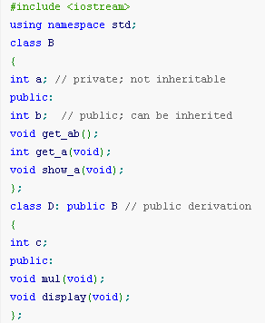
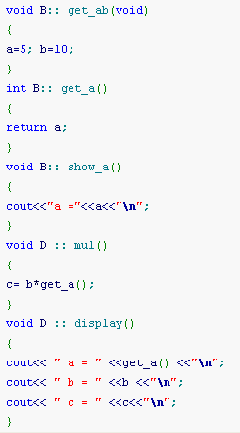

Slide 15
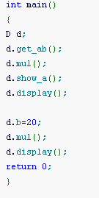

Slide 16
Output
a =5
a = 5
b = 10
c = 50
a = 5
b = 20
c = 100

Slide 17
Code Walkthrough
The class D is a public derivation of the base class B.
Therefore, D inherits all the public members of B and retains their visibility.
Thus a public member of the Base class B is also a public member of the derived class D.
The private members of B cannot be inherited by class D.
The class D, in effect, will have more members than what it contains at the time of declaration.

Slide 18
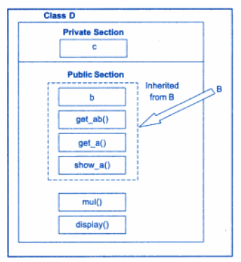
Adding more members to a class by Public derivation

Slide 19
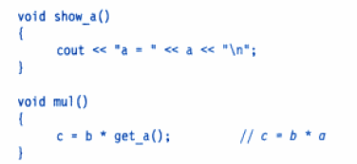
Public derivation
The program illustrates that the objects of class D have access to all the public members of B.
Let us have a look at the functions show_a() and mul();
Although the data member a is private in B and cannot be inherited, objects of D are able to access through an inherited member function of B.

Slide 20
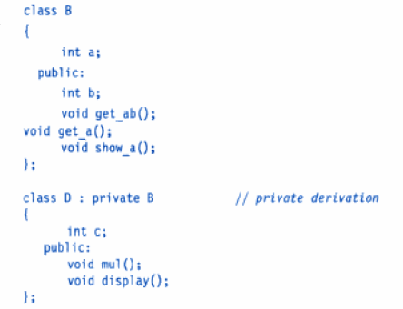
Case: Private Declaration

Slide 21
Private Declaration
The members of the derived class D is shown as follows.
In private derivation, the public members of the base class become private members of the derived class.
Therefore, the objects of D cannot have direct access to the public member functions of B.

Slide 22
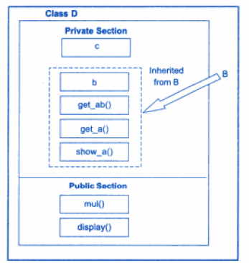
Adding more members to the class (Private Declaration)

Slide 23

Private Declaration
The statements will not work.

Slide 24
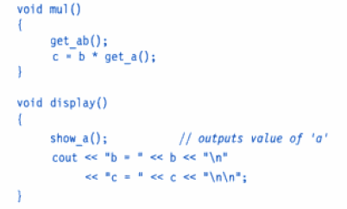
Private Declaration
However, these functions can be used inside mul() and display() like normal functions as shown below.

Slide 25
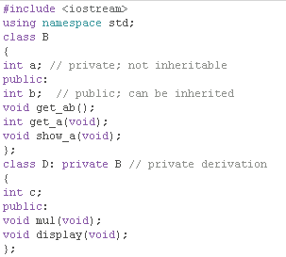
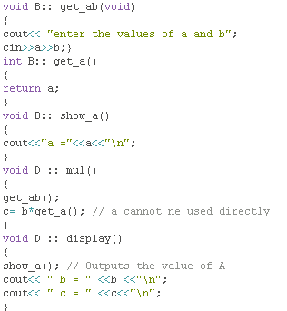

Slide 26
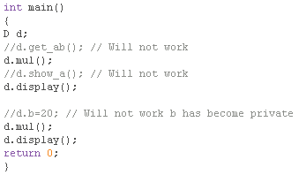

Slide 27
Output
Enter the values of a and b : 5 10
A= 5
B=10
C= 50
Enter the values of a and b : 12 20
A= 12
B=20
C=240

Slide 28
Key point
Suppose a base class and a derived class defines a function of the same name.
What will happen when a derived class object invokes the function?
In such cases, the derived class function supersedes the base class definition.
The base class function will be called only if the derived class does not redefine the function.

Slide 29
Program: Inheritance using Public Specifier

Slide 30
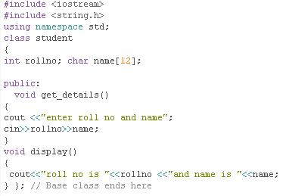
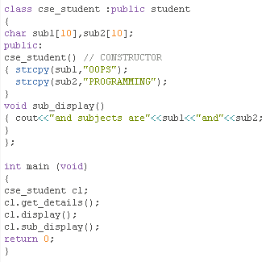
Public members of base class are accessed as public of derived

Slide 31
Output
enter roll no and name 12 ABC
roll no is 12
and name is ABC
and subjects are OOPS and
PROGRAMMING

Slide 32
Program: Inheritance using Private Specifier

Slide 33
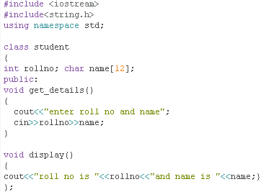
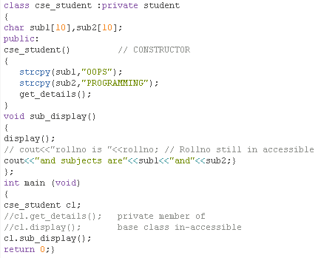

Slide 34
Output
enter roll no and name100 ABC
roll no is 100 and name is ABC
and subjects are OOPS and PROGRAMMING

Slide 35
Making a Private Member Inheritable

Slide 36
Summary
How to increase the capabilities of an existing class without modifying it?
A Private member of a base class cannot be inherited and therefore it is not available for the derived class directly.
What do we do if the private data needs to be inherited by a derived class?
This can be accomplished by modifying the visibility limit of the private member by making it public.
This would make it accessible to all the other functions of the program, thus taking away the advantage of data hiding.

Slide 37
Protected Modifier
C++ provides a third visibility modifier, protected, which serve a limited purpose in inheritance.
A member declared as protected is accessible by the member functions within its class and any class immediately derived from it.
It cannot be accessed by the functions outside these two classes.

Slide 38

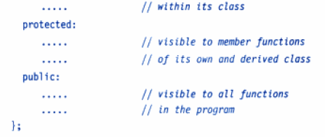
Access Specifier
A class can now use all the three visibility modes as illustrated below.

Slide 39
Protected Member inherited in Public Mode
When a protected member is inherited in public mode,
it becomes protected in the derived class too and therefore is accessible by the member functions of the derived class.
It is also ready for further inheritance.

Slide 40
Protected Member inherited in Private Mode
A protected member, inherited in the private mode derivation
It becomes private in the derived class.
Although it is available to the member functions of the derived class, it is not available for further inheritance (since private members cannot be inherited).

Slide 41
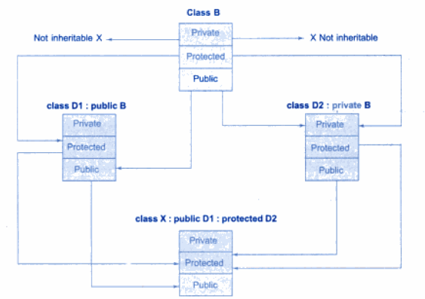
Effect of Inheritance on the Visibility of members

Slide 42
Key points
It is also possible to inherit a base class in protected mode (known as protected derivation).
In protected derivation, both the public and protected members of the base class become protected members of the derived class.

Slide 43
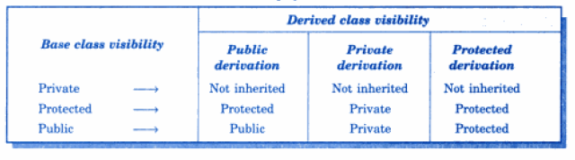
Visibility of base class members
Table summarizes how visibility of base class members undergoes modifications in all the three types of derivation.

Slide 44
Multilevel Inheritance
When a class is derived from another derived class is called multilevel inheritance.
It is implemented by defining at least three classes.
It has a Base class, an intermediate base class and a derived class.

Slide 45
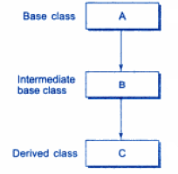
Multilevel Inheritance

Slide 46

Example: A Derived class with multilevel inheritance

Slide 47
Example:
Assume that the test results of a batch of students are stored in three different classes.
Class student stores the roll number,
Class test stores the marks obtained in two subjects
Class result contains the total marks obtained in the test.
The class result can inherit the details of the marks obtained in the test and the roll-number of students through multilevel inheritance.

Slide 48
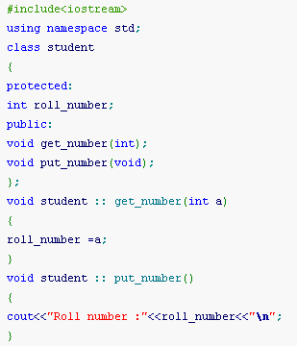
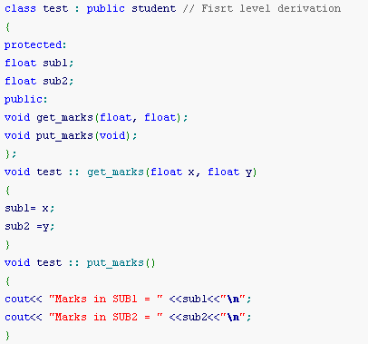

Slide 49
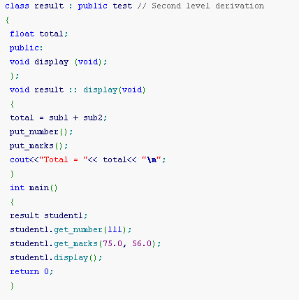
Since the classes are derived in public mode: private/protected/public members of base class will remain private/protected/public in derived class

Slide 50
Output
Roll number :111
Marks in SUB1 = 75
Marks in SUB2 = 56
Total = 131

Slide 51
Multiple Inheritance
A class can inherit the attributes of two or more classes.
This is known as multiple inheritance.
It allows us to combine the features of several existing classes as starting point for defining new classes.

Slide 52
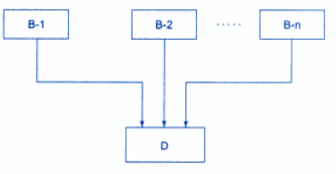
Multiple Inheritance

Slide 53
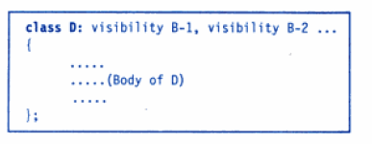
Syntax of Derived class with Multiple Inheritance
The visibility may be either public or private.
The base classes are separated by comma.

Slide 54
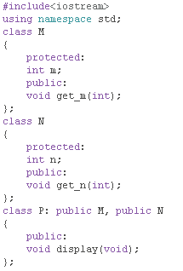
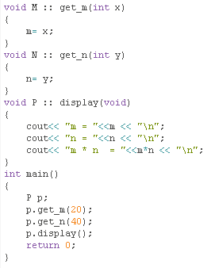

Slide 55
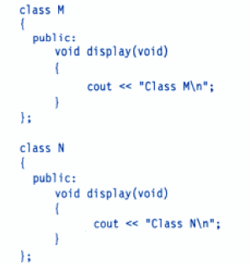
Ambiguity Resolution In Inheritance
At sometimes, we may face a problem in using the multiple inheritance , when a function with the same name appears in more then one base class.
Consider the example.

Slide 56
Ambiguity Resolution In Inheritance
Which display() function is used by the derived class when we inherit these two classes?
We can solve this problem by defining a named instance within the derived class, using the class resolution operator.

Slide 57
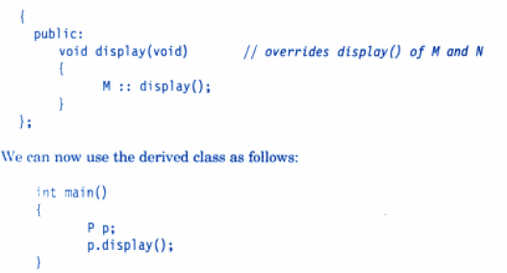
Ambiguity Resolution In Inheritance

Slide 58
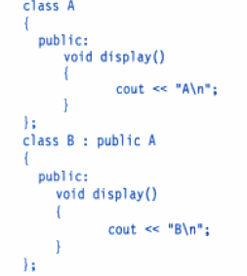
Ambiguity in Single Inheritance

Slide 59
Ambiguity in Single Inheritance
In this case the function in the derived class overrides the inherited function and therefore, a simple call to display() by B type object will invoke function defined in B only.
However, we may invoke the function defined in A by using the scope resolution operator to specify the class.

Slide 60

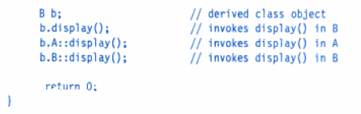

Ambiguity in Single Inheritance

Slide 61
Hierarchical Inheritance
When more than one classes are derived from a single base class, such inheritance is known as Hierarchical Inheritance, where features that are common in lower level are included in parent class.
Problems where hierarchy has to be maintained can be solved easily using this inheritance.

Slide 62
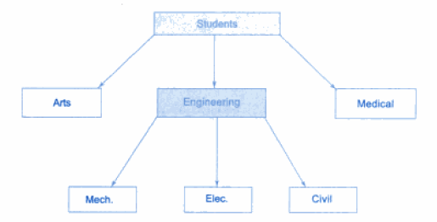
Hierarchical classification of Students

Slide 63
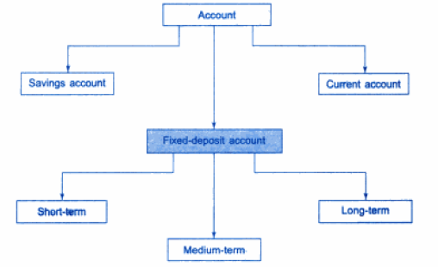
Classification of bank accounts

Slide 64
Example
#include<iostream.h>
#include<conio.h>
#include<string.h>
class college
{
protected:
char name[12];
void disp()
{
cout<<"name of college is"<<name<<endl;}
public:
college()
{cout<<"constructor of college is called"<<endl;
strcpy (name, "PIET");
}};
class cse_dept : public college
{
int faculty;
public:
void get_faculty()
{
cout<<"enter no of faculty members in CSE" <<endl;
cin>>faculty;}
void display()
{ disp(); // now a protected member of cse_dept
cout<<"no of teachers in CSE "<<faculty<<endl;
}
};

Slide 65
class ece_dept : public college
{
int faculty;
public:
void get_faculty()
{
cout<<"enter no of faculty members in ECE"<<endl;
cin>>faculty;}
void display()
{
disp();// now a protected member of ece_dept
cout<<"no of teachers in ECE "<<faculty<<endl;}};
void main()
{ clrscr();
cse_dept C;
C.get_faculty();
ece_dept E;
E.get_faculty();
C.display();
E.display();
}

Slide 66
OUTPUT
constructor of college is called
constructor of college is called
enter no of faculty members in CSE
12
enter no of faculty members in ECE
36
name of college is PIET
no of teachers in CSE 12
name of college is PIET
no of teachers in ECE 36

Slide 67
Hybrid Inheritance
Hybrid inheritance is combination of two or more inheritances such as single, multiple, multilevel or Hierarchical inheritances.

Slide 68
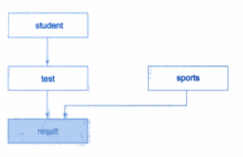
Exmple of Hybrid Inheritance: Multilevel, Multiple inheritance

Slide 69
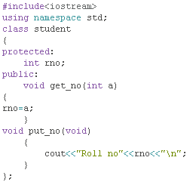
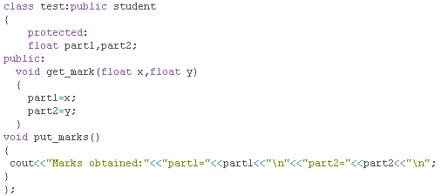

Slide 70
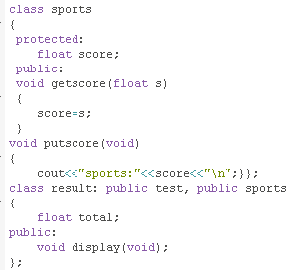
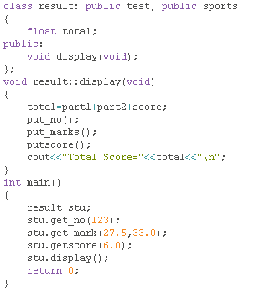

Slide 71
Output
Roll no123
Marks obtained:
part1=27.5
part2=33
sports:6
Total Score=66.5

